Slide 1







PROJECTS | PRODUCTS | COURSE | INTERNSHIP
info@discoverprojects.com
www.discoverprojects.com
pro.aiskool@gmail.com
www.aiskool.com
Shop no. 2, Narayan Smurti Building, Opp. Saraswati Book Depot,
Near CIDCO Bus Stop, Thane West, India.
+91 9967478289 / +91 9167769993

Slide 2

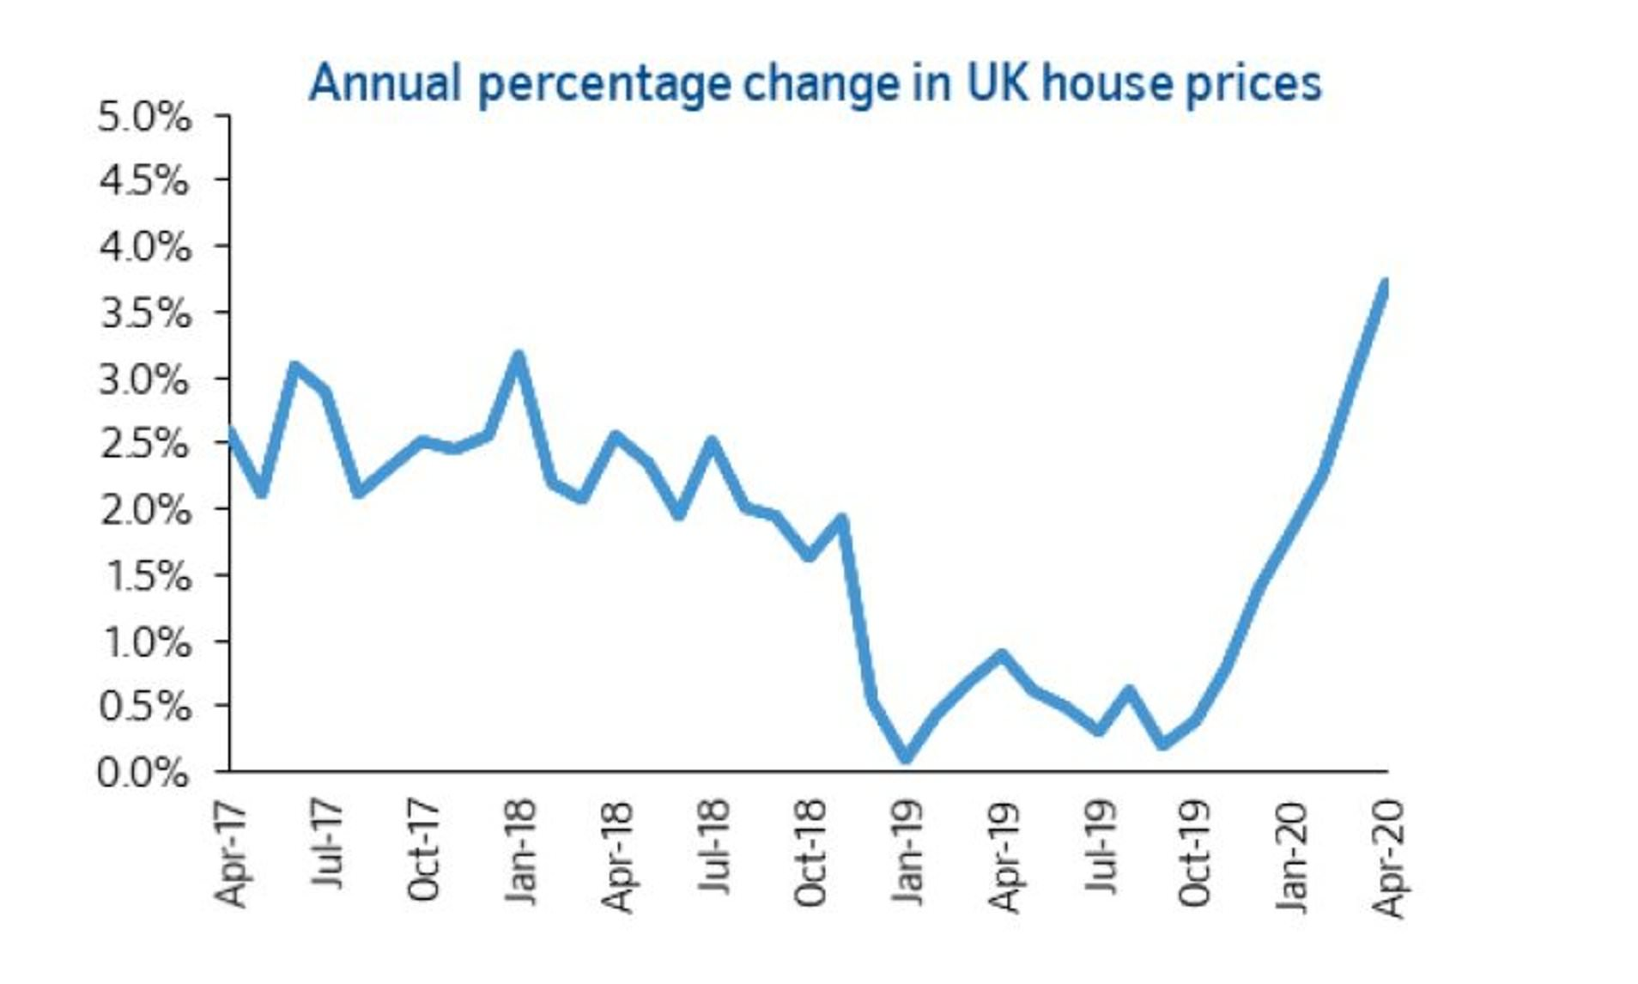
Predicting House Prices
Relevant Image

Slide 3
Introduction and Application
The objective is to build a prediction engine for prediction of house prices using Neural Network.

Slide 4
Working
FIRST STEP WAS TO COLLECT DATA FROM DIFFERENT SOURCES FOR OUR PROBLEM STATEMENT .
THEN WE HAVE TO CLEAN , PROCESS CATEGORICAL DATA AND NORMALISE IT.
THEN WE SHOW VARIOUS ANALYSIS USING GRAPHS.
SPLIT THE DATA INTO TRAINING AND TEST SET.
SELECT AN ALGORITHM.
FITTING THE MODEL TO TRAINING SET.
CHECK ACCURACY OF TRAINED DATA W.R.T TRAIN SET.
TEST THE TRAINED MODEL W.R.T TESTING SET.
CHECK ACCURACY OF TEST DATA W.R.T TEST SET.
BASED ON THE GENERATED GRAPHS WE CAN PREDICT THE HOUSE PRICES.

Slide 5
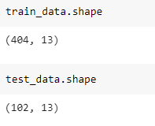
Working and Building
This is the data that we are using for the analysis of newswires. The dataset has been taken from keras.dataset.

Slide 6
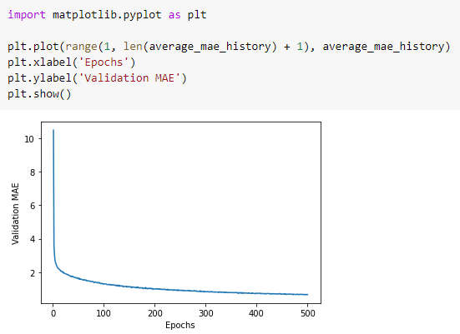
Graphs
Here we have plotted a graph between epochs and validation using the plot function of the matplotlib library.

Slide 7
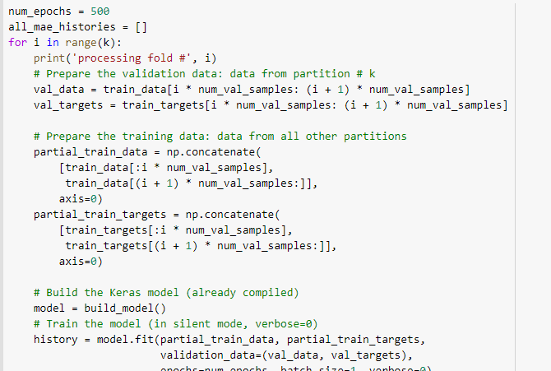
Selecting Algorithm
A neural network is a series of algorithms that endeavors to recognize underlying relationships in a set of data through a process that mimics the way the human brain operates.

Slide 8
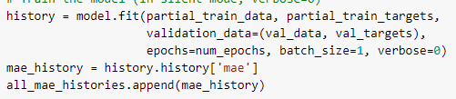
Fitting of Data
A neural network is a series of algorithms that endeavors to recognize underlying relationships in a set of data through a process that mimics the way the human brain operates.

Slide 9
Evaluate, Tune and Improve Neural Network
Mean Square Error: MSE is calculated by taking the average of the square of the difference between the original and predicted values of the data.

Slide 10
FAQ
What is the use of read_csv()?
read_csv() is an important pandas function to read csv files and do operations on it.
2. How to choose the number of hidden layers and nodes in a feedforward neural network?
The number of hidden neurons should be between the size of the input layer and the size of the output layer.
The number of hidden neurons should be 2/3 the size of the input layer, plus the size of the output layer.
The number of hidden neurons should be less than twice the size of the input layer.

